Slide 1
Inquiry Group:
Welcome!
Impact Evaluation & Data Analysis

Slide 2
Inquiry Group:
Focus:
The focus of this discussion will be to share experiences, insights and lessons learned about how to assess the efficacy of initiatives and quantify the kinds of change we as a network of organizations are trying to support.
Format:
Building on lessons learned in the April 5th, 2012 Inquiry Group call, this iteration will be a facilitated dialogue. Participants will be invited to share their organizational or individual perspectives on key questions relating to evaluation challenges or achievements for consideration by the group.
Expected Outcomes:
Developing a list of ‘best-practices’ for evaluation & analysis
Understanding the Anatomy of Failure - What can we learn?
Others to be identified during the call…

Slide 3
Impact Evaluation:
‘Impact’ – Changes attributable to a particular project, program or policy
Method to assess whether an intervention is causally related to an observed effect among a target community
Notes:
The word ‘Impact’ is used regularly, but I’ve found what we’re usually talking about is something much weaker than a formal causal story;
Both ‘What’ we measure in terms of metric sand ‘How’ we go about measuring it in terms of research methods change the kind

Slide 4
Impact Evaluation:
http://www.youthmovements.org/hub/
Notes:
This is a great resource that is available on the YouthMovements Knowledge Hub – ‘Impact Evaluation in Practice’

Slide 5
Notes:
Everyone says impact… what do they mean?
What does my program do?
What does it purport to achieve?
What change does it create?
For whom?
How much?
How?
How do you know?
What are some typical ways people assess the efficacy of their projects / programs?
Did the funding get secured / renewed?
Achieving international media attention?
People are banging down the door to join your advisory / board?
CSR initiatives are seeking your organization out as a preferred community partner;
Universities are looking to partner with you;
PM Variances (Scope, Time, Cost);
Project-level accounting shows you are able to achieve your objectives more efficiently (less resources (time, materials, human capital);
Is the trend towards sustainability / growth? (Scalability?)
Return on Investment (ROI?)
What aren’t we talking about?
Program evaluations conducted by your organization, for your organization;
What is the distinction:
- Marketing & PR material vs. Research

Slide 6
Notes:
Why measure impact?
Impact Evaluation is a formal tool to help policy makers, funders and organizations understand what interventions are creating the most substantive change among a particular target community.
Changing trends:
Global financial crisis: Governments, individuals, corporate foundations have less to spend; social pressures are diluted due to economic concerns;
Trends moving into 2012 are more positive than they have been for the past few years, but the funding landscape has changed;
Distinction:
Charity: “I have money, resources and I want to give them to someone – I choose you.”
Philanthropy: “I have money and I want to invest resources to create a measurable change; If you can do more with less, my money is yours”
Social Enterprise: “An organization that applies business strategies to achieving philanthropic goals” (wikipedia)
Ethos Water, Foundry 47: Peter Thum;
Impact Investment: “investments made based on the practice of assessing not only the financial return on investment, but also the social and environmental impacts of the investment that happen in the course of the operations of the business and the consumption of the product or service which the business creates” (Wikipedia)
Example: You have $100k to donate and there are three programs all working in the same region on an issue. Which one deserves your investment?

Slide 7
Notes:
- Need to prove that our method ‘works’, but how? What does it mean for a program to be ‘working’
- How do we create transformative change?; We need is a theory that tells the full story of our intervention.
- What is the narrative for this story?
“[A Theory of Change] describes the causal logic of how and why a particular project, program, or policy will reach its intended outcomes” (Gertler et. Al. pp. 22”. pp. 22)
Linear, Causal models that demonstrates that our intervention is singularly responsible for positive changes on key metrics for our target population;
-What do we need to be able to tell this story?
Work to establish CAUSATION as distinguished from CORRELATION;
[Reference to Dominos in the slide – ‘Human domino’]

Slide 8
Notes:
What are the critical differences between ‘there is a change’ and ‘we caused a change’?
Three Concepts: Dependence, Correlation and Causation
Dependence:
Different relationships that can obtain between two or more random variables or datasets;
Broadly speaking, where a relationship exists, the two are said to bear a ‘relationship of dependence’ to one another;
Correlation:
Pearson product-moment correlation coefficient or (Pearson’s correlation) works to detect linear dependencies between two variables; Does a positive increase in one predict a positive increase in another; (Reference the slide images)
Problem of Silent Co-Variates: Just because an increase in the number of Facebook users is positively correlated with the yield on 10-year Greek government bonds, does not mean that one stands in a causal relationship to the other;

Slide 9
Notes:
We have to prove it:
Define the Theory’s five components;
Order their relations;
Test via Counterfactuals:

Slide 10
Inputs
Notes:
What are the components of a Theory of Change?
Inputs:
Financial, human and other resources mobilized to support activities;

Slide 11
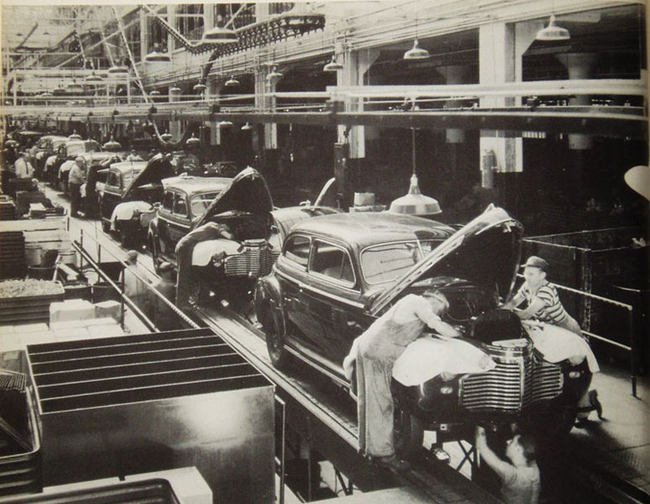
Activities
Notes:
Activities:
Actions taken or work performed to convert inputs into specific outputs;
Image of an Assembly line, that brings together raw materials, with people doing the work to create a car;

Slide 12
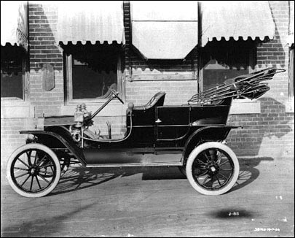
Outputs
Notes:
Outputs:
Products resulting from converting inputs into tangible outputs:
Finished Car:

Slide 13
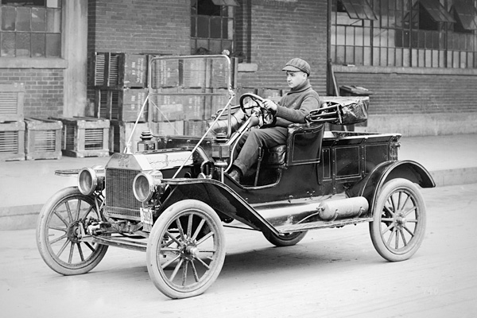
Outcomes
Notes:
Outcomes:
Use of outputs by targeted population:
People are driving -

Slide 14
Final Outcomes
Notes:
Final Outcomes:
The final objective of the program: Long-Term Goals
Urban Sprawl – people can live further from the city and travel in, with positive / negative implications;
World is functionally ‘smaller’ – more connected which has huge implications (positive and negative) on quality of life from healthcare to industry;

Slide 15
Notes:
Impact Evaluation: the “how” is a function of experimental design
Sample definitions & Counterfactual Research Design: pp. 54
Compare groups of statistically equivalent populations (by demographic variables like age, gender, region, income, education etc.);
External Validity: “the impact estimated in the evaluation sample can be generalized to the population of all eligible units” (RAOSOFT.com Sample Size Calculator)
Internal Validity: “the estimated impact of the program is the net of all other potential confounding factors, or that the comparison represents the true counterfactual, so that we are estimating the true impact of the program

Slide 16
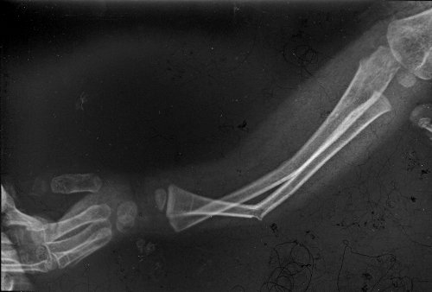
Notes:
Sample definitions & Counterfactual Research Design: pp. 54
Treatment Group / Arm: Intervention is Present
Comparison Group / Arm: Intervention is Not present

Slide 17
Evaluation Sample
Population of Eligible Units
Comparison Group:
Not assigned to treatment
Treatment Group:
Assigned to treatment
Random Selection
Random Selection
Random Selection
Notes:
Sample definitions & Counterfactual Research Design: pp. 54
Compare groups of statistically equivalent populations (by demographic variables like age, gender, region, income, education etc.);
External Validity: “the impact estimated in the evaluation sample can be generalized to the population of all eligible units” (RAOSOFT.com Sample Size Calculator)
Internal Validity: “the estimated impact of the program is the net of all other potential confounding factors, or that the comparison represents the true counterfactual, so that we are estimating the true impact of the program

Slide 18
α = (Y|P=1) – (Y|P=0)
α = Impact/Causal Effect
P = Project or Program
Y = Outcome of Interest
Notes:
Represents the following question: “What is the impact or causal effect of a program P on an outcome of interest Y?".
Calculates the difference between the state of the variable Y in the presence of the intervention or program and the state of Y in the absence of the intervention or program.

Slide 19
α = ($5000|P=1) – ($1000|P=0)
α = Impact/Causal Effect
P = Participation in an E-Course
Y = Amount of seed funding secured for projects
“Participation in this E-Course has increased the average amount of seed funding secured by individuals by a factor of five”
Notes:
Stakeholders:
Bands, concert-goers, venues, potential corporate sponsors, labels, media partners, for-profit companies with environmental focus (zip car etc.), equipment suppliers, communities around venues
Sample:
Regular Concert-Goers vs. Non-Regular Concert-Goers;
Claim:
“Using Green Shades as your event / talent management partner delivers strong turn-out of music-buying fans who promote shows at a lower cost than traditional marketing based on ‘carbon neutral’ initiative”
Data Acquisition:
Give everyone voting cards and ask for their opinions on key issues at the show; Repeat at successive shows (Data Acquisition)
Establish a baseline by conducting interviews on college campuses; (Data Acquisition)
Establish a baseline by conducting interviews at venues around the city; (Data Acquisition)
Establish a relationship with an online ticket agent to share purchaser data; (Data Acquisition)
Create an online community to build social capital via competition board around ‘# of concerts attended’ (Data Acquisition)
Create a sign-up online for each show; (Data Acquisition)
Create a text-based sign-up for details about the show to track participants; (Data Acquisition)
Environmental Metrics:
Reduction in water, energy, food etc: How does your method prove ‘carbon neutrality’? What do non-carbon neutral events create?
What about noise pollution? (The Dakota / Ossington Strip in Toronto)
Tell everyone in the restaurant to eat vegetarian for the night and calculate reduction in carbon?
Participation Metrics:
We can track the purchases uniquely associated with each email address for those purchasing tickets; (Participation Metrics)
We can track changes vs. the average number of concerts attended by people not involved in the green shades program (Participation Metrics)
Financial Metrics:
Describe the number of independent recordings financed through funds raised through the program; (Financial Metrics)
Funds raised on average per event vs. standard shows with different revenue model; (Financial Metrics)
Exposure Metrics:
Number of attendees + Demographics – very lucrative for marketers or for possibilities around merchandising / promotional partnerships; (Exposure Metrics)
Number of ‘new fans’ on FB/band mailing lists generated through events (Exposure Metrics)

