Slide 1
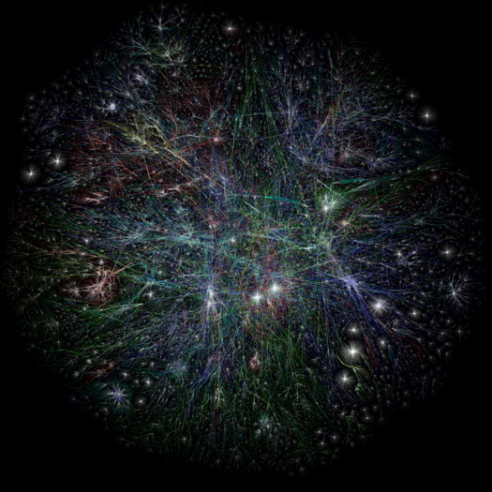
Everyone Welcome
Notes:
OPTE internet Mapping project
Beautiful, organic, complex, expanding

Slide 2
1)Introductions 10-15 mins
2) Campaign update 10 mins
what have we been up to thusfar,
what's coming next
3) Knowledge sharing
Challenges
Timeline creation
4) Discussion
Connecting the Arab spring to the American Autumn
Rio+20 and issue convergence

Slide 3
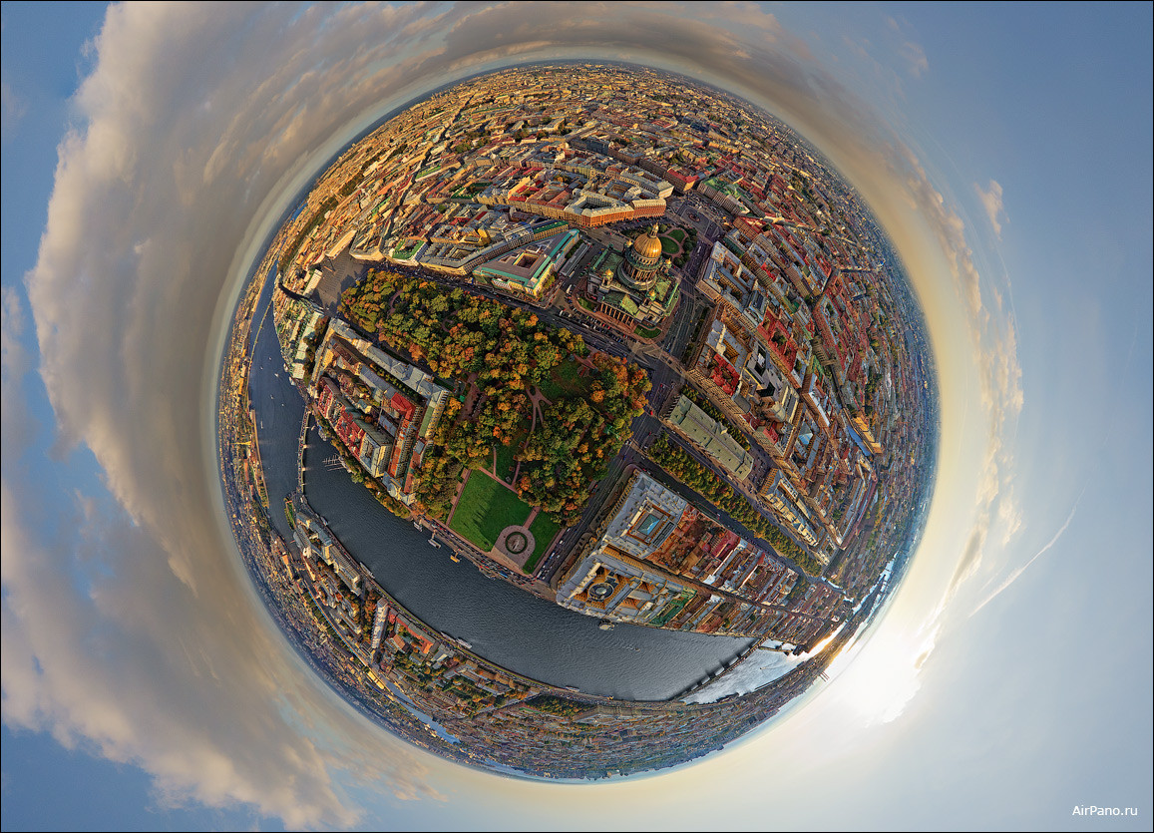
Introductions

Slide 5
What emerging themes are have you been seeing in your work recently?

Slide 6
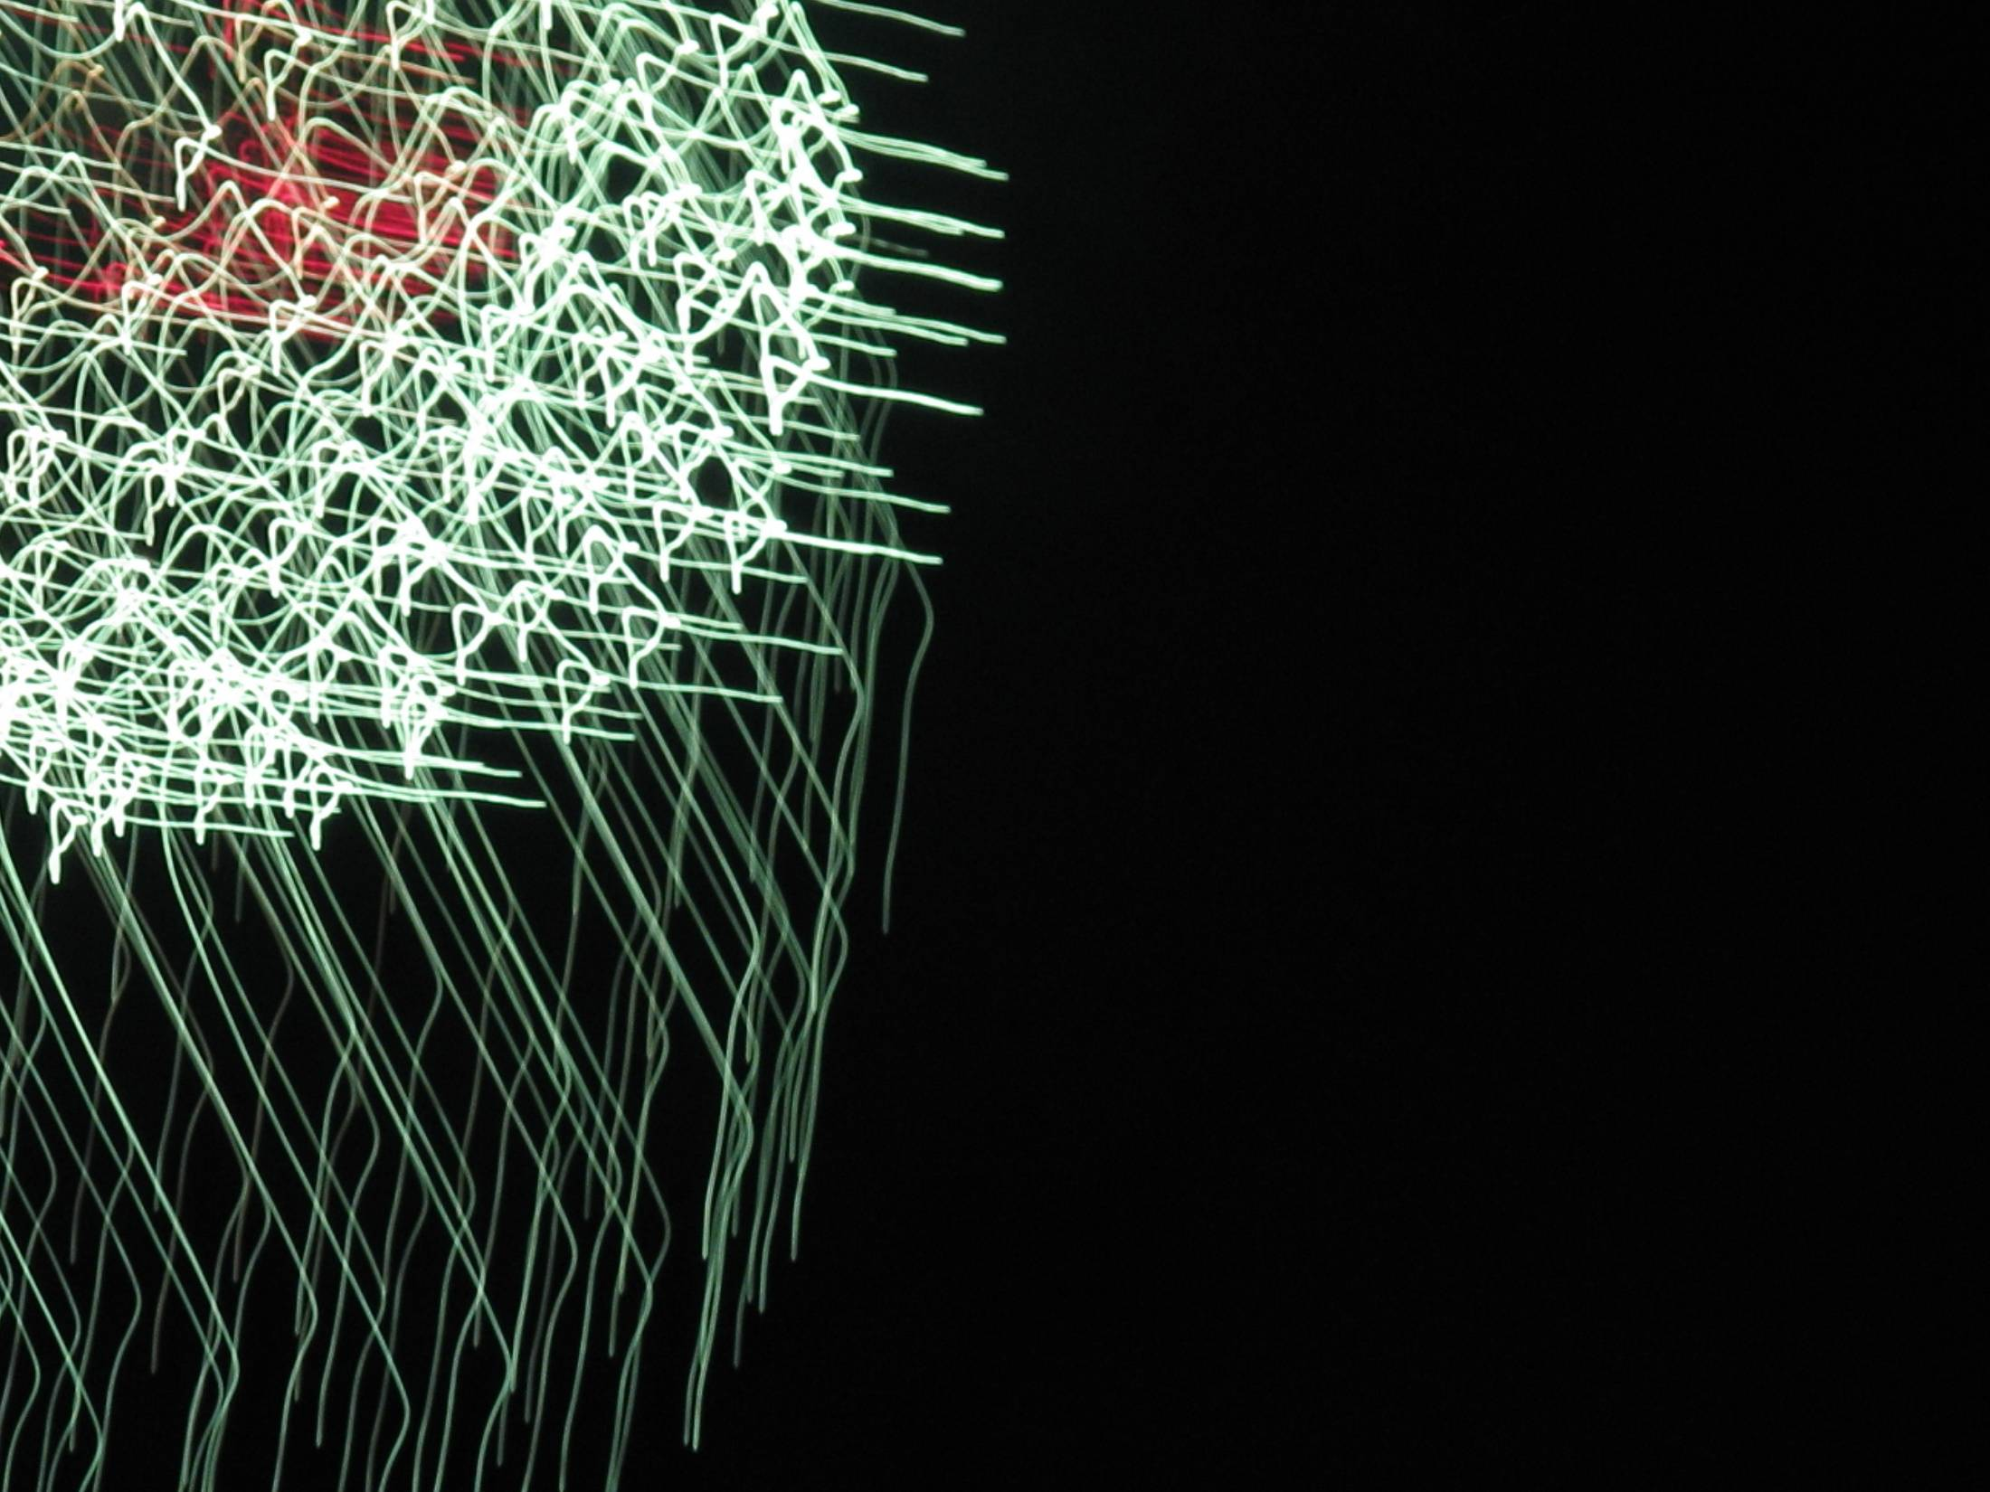
What is our
strategic
political
moment?

Slide 7
http://map.15october.net/main

Slide 8
Each of us is called upon
to embrace the conviction
that we have the power within us to create the world anew. —Grace Lee Boggs

Slide 9
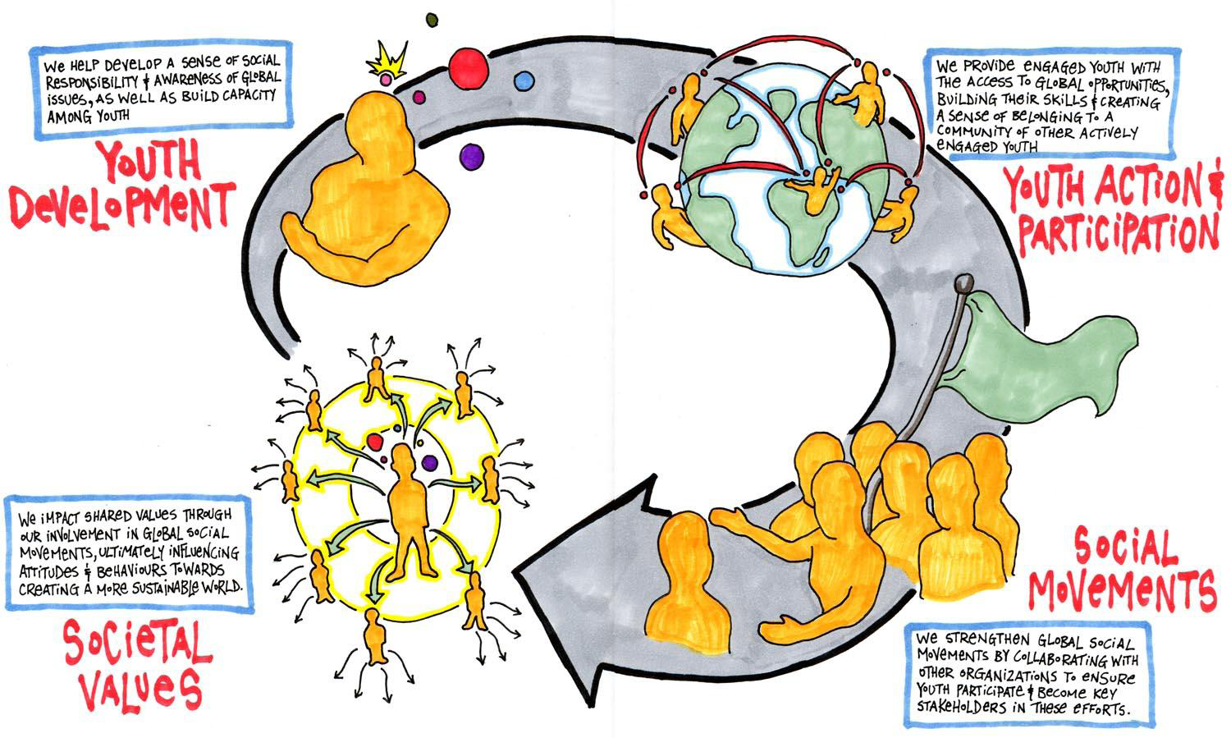
Notes:
Our model of change:
1)To build capactiy of youth & allow them to develop a sense of social responsibility and global awareness
2)We provide engaged youth with access to global opportunities and a way to stay connected with other active people like themselves
3)Strengthen global social movements by collaborating with other organizations to ensure youth participation and to allow them to become key stakeholders in these efforts
4) Impact the shared values through our involvement in these social movements, influencing attitudes and behaviours towards a more just and sustainable world

Slide 10
In our political landscape, this is what we have to leverage.
Notes:
To provide an inclusive environment
Start by mapping your stakeholders, invite them to the table – revisit the goal for buy-in , determine who has capactiy for what
Use inclusive language and be warm to differences of opinion
Provide opportunities for Engagement – youth are often tokenized
Watch out for accidental linkages – often the most valuable in the long term.
Ensure that expectations are clear from the beginning
Inverse size of commitment to size of audience and level of engagement – example of UTERN
Be positive and passionate -> leads to magnetism which will bring in new people

Slide 11
Stay in contact : liam@takingitglobal.org

